Slide 1
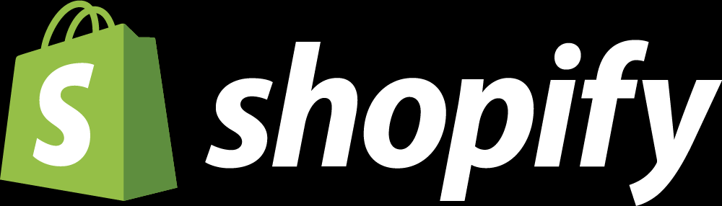
How product management can help you make great decisions
Chanel Fournier
Senior Product Manager

Slide 2
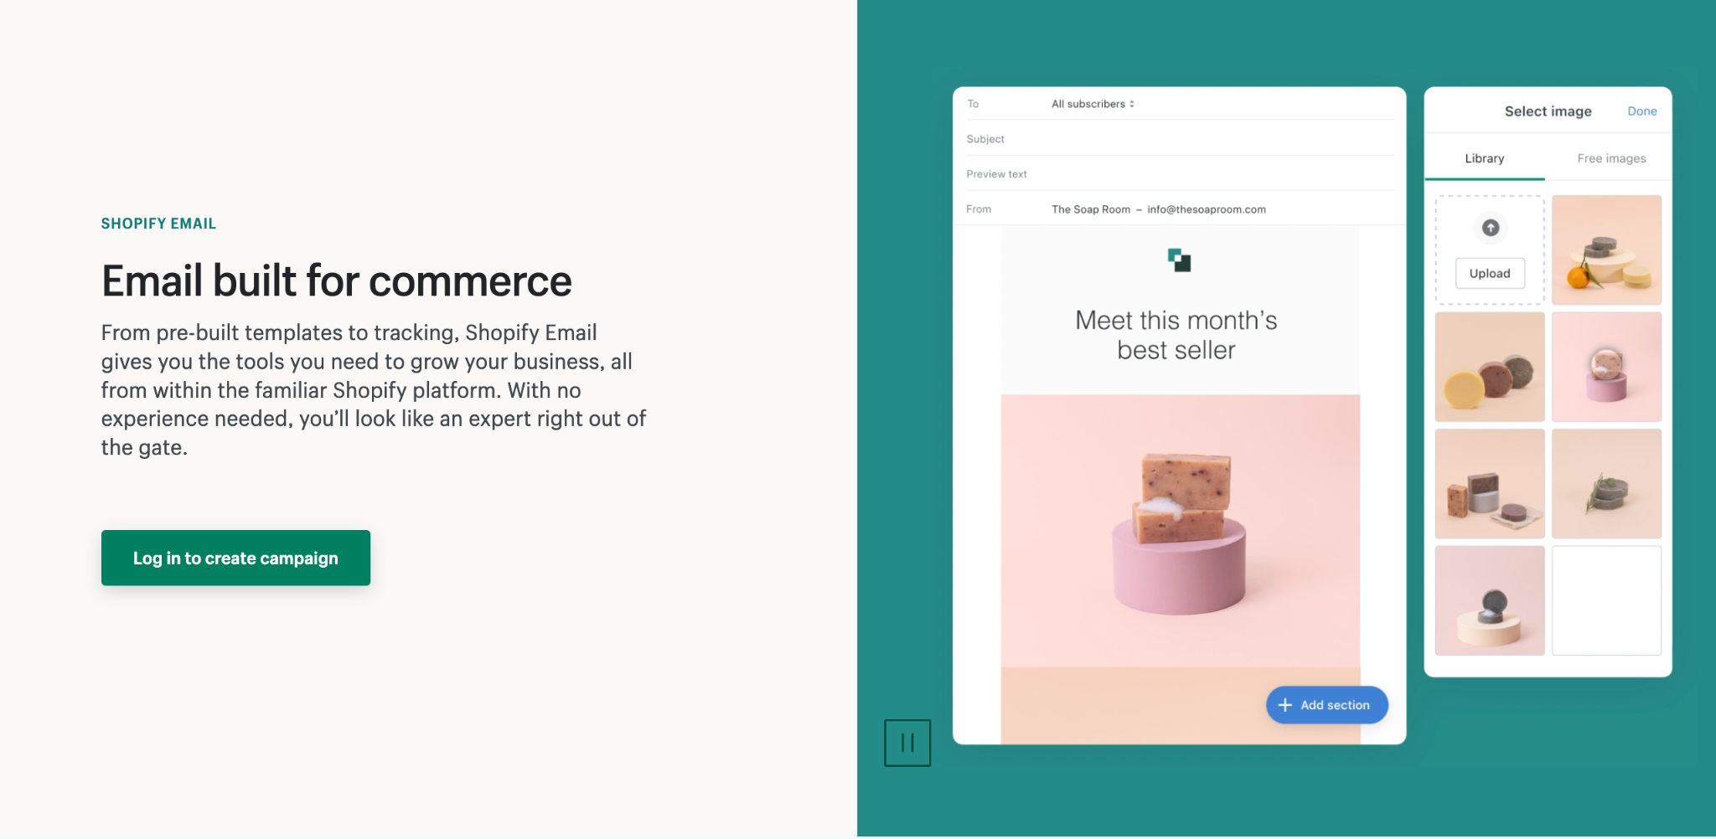
Launched Shopify Email to over 1M users in April 2020, 3 months early and during COVID.

Slide 3
Product principles

Slide 4
Thrive on change

Slide 5
Thrive on change
Change is here
Change is hard, change is unavoidable, change is constant. It can mean volatility, randomness, disorder, and stress.
This environment can be overwhelming. Terms like 'impostor syndrome' may resonate. This is normal. Change is difficult.
But if we want to grow, we need to see and appreciate the benefits of change, and learn to thrive in an environment that’s always moving. Through this, we’ll see that the rewards of change are greater than the risks of certainty.﻿
Operating under the assumption that tomorrow will be the same as today is a path to failure.
Get comfortable with being uncomfortable, embrace uncertainty.

Slide 6
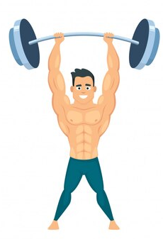
Thrive on change
Anti-fragile
Fragile things (fine china, portfolios only invested in a single position, a “why me” mentality) easily break in the face of pressure, chaos, and volatility.
Robust or resilient things (a piece of metal, broadly diversified portfolios, stoicism) endure change.
Antifragile things (options, muscles, a “failure leads to growth” mentality) benefit from stress, volatility and change. Fragility implies you’ve got more to lose than to gain. Antifragility implies you’ve got more to gain than to lose.
The concept was developed by Nassim Nicholas Taleb’s and here is how he defines it in his book Anti-Fragile:
Some things benefit from shocks; they thrive and grow when exposed to volatility, randomness, disorder, and stressors and love adventure, risk, and uncertainty. Yet, in spite of the ubiquity of the phenomenon, there is no word for the exact opposite of fragile. Let us call it antifragile.

Slide 7
Anti-fragile
Shopify is antifragile A company that benefits, thrives and grows when exposed to volatility, randomness, disorder, or stressors.

Slide 8
Focusing on impact

Slide 9
Focusing on impact
What is your why?
Everyone has the potential to have a positive impact.
It’s through the challenges you accept and conquer, the projects you choose to work on, and the environment you create for those around you. It’s doing the tasks that no one else will, and learning to say ‘no’ when necessary.
Impact is the sum of all the decisions and actions that result in a net positive outcome on our mission. Keep this at the core of everything you do.
You’ll have limited impact if you act alone. The best products come from a mix of ideas, experiences, and perspectives. Understand the interdependencies of your work and how it shows up in the end result, appreciate others’ perspectives, remove roadblocks for one another, and prioritize what’s best for the organization. This is the path to collective impact.
The best products have the most impact. They focus on solving the most important problems.

Slide 10
Constant learner

Slide 11
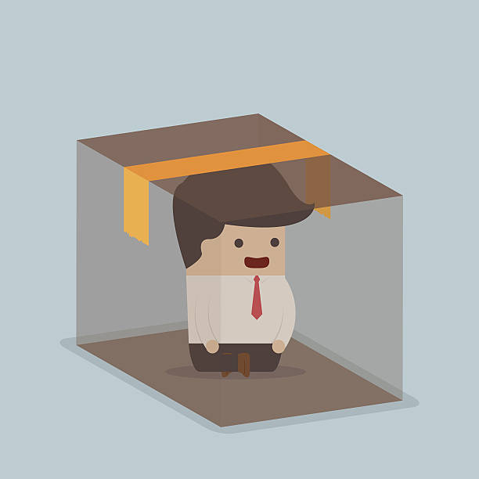
Constant learner
Commit to learning
Because change is constant, we need to be perpetual and deliberate learners.
Deliberate learners make a commitment to continuously improve their skills and knowledge. It takes a lifetime of work.
To have the greatest impact, identify gaps in your skills and knowledge and develop them. Remain curious about what you don’t know rather than protecting what you do.
Be both a learner and teacher. Learning in isolation doesn't work; we need to teach one another, share context, mistakes, and learnings so we don’t repeat them. Learn from other’s mistakes without judgement. Give direct, real-time feedback with personal care, and actively seek it to continuously learn and grow.

Slide 12
Build for the long term

Slide 13
Slide section title
Solutions that can adapt to change
Always strive to find the simplest solution. Complex solutions will be difficult to build upon.
Finding a simple solution is a lot harder than finding a complex solution.
This is fundamentally challenging because we work on solving complex problems. If there is no simple solution, reframe the problem until one emerges.﻿
A well written 1 page brief is worth a lot more than a 20 page document
Optimize for long term growth over short term impact.
Break down your long term solution (product vision) in bite size implementations (projects).

Slide 14

Slide section title
Focus on the green path
When building a product, we never (and arguably shouldn’t) know exactly where it will end up and how we’ll get there.
We should know the problem it’s solving, our goals and ambitions for it, and the general direction we’re heading in - this is called the green path.
What we can do is map out the steps along the way which lead us in the direction we need to go. The green path is any work that gets us closer to our intended destination. The step-by-step journey towards long-term success.

Slide 15
Making great decisions quickly

Slide 16
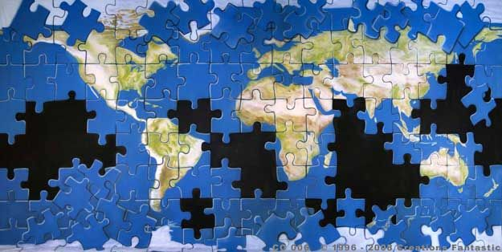
Slide section title
The work we do is the sum of the decisions we make.
To make great decisions, you need to context. Seek out the information you need – get curious, ask questions, connect with others, explore other perspectives, and do your research.
You won't always have all the information, people, or tools you need. Embrace these constraints to uncover new ways of doing things.
Balance having enough context to make informed decisions, but not waiting too long until the opportunity has passed. The effort to make that decision should be proportionate to what it would take to reverse it. Learn to make decisions without all the pieces of the puzzle
Decisions should come from trusted people with the greatest context. Don’t seek consensus or majority approval on every decision. Distributed decision making allows to move fast and adapt quickly to our changing environment.

Slide 17
Ideation and iteration

Slide 18
Ideation & iteration
Creativity is a culture Move fast, fail quickly, learn, and pivot as you try new ideas.

Slide 19
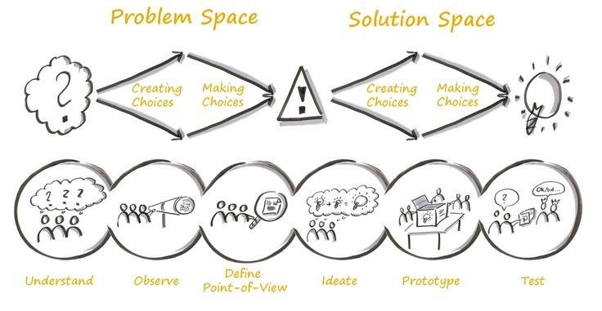

Slide 20
Iteration and ideation
Experimentation
The scientific method has existed since the 1600’s
Make an observation of a problem
Ask a question
Form a hypothesis
Do an experiment
Analyze results
Try again or keep going

Slide 21
Iteration and ideation
Experimentation
The scientific method has existed since the 1600’s
Make an observation of a problem
Focusing on impact
Ask a question
Be a constant learner
Form a hypothesis
Build for the long term
Do an experiment
Iterate
Analyze results
Thrive on change
Try again or keep going
Make great decisions

Slide 22
Public and private sectors

Slide 23
Focusing on impact
Problem solver
Great products should be focused on solving real problems, whether in the private or public sector.
We can only build the best products by relentlessly understanding user’s struggles, having deep care, and being committed to helping them succeed every step of the way, regardless of sectors.

Slide 24
Thank you.

